Slide 1


Editing and Translation
The inside story of how translation works and why, and insights on how to edit translations effectively and with confidence.
Presented by: Shelley Fairweather-Vega, FairVega Translations
Moderator: Sarah Peterson
Hosted by: MariLou Harveland, Vice President – Member Services
July 13, 2020

Slide 2
Welcome
MariLou Harveland (mharveland@gmail.com)
Guild Announcements
• Wednesday, July 22 from 5:00-6:15 PM (PST) – Happy hour hosted by Erin Cusick to further discuss editing translations from tonight’s meeting.
• August 17, 2020 from 5:00-7:00 PM (PST) - PerfectIt! tutorial with founder Daniel Heuman.
• Editors Guild Board (2021) recruitment happy hours (TBD) – Summer 2020!
July 13, 2020
Notes:
On behalf of the NW Editors Guild, I’d like to welcome you all to our July 2020 member meeting. I’m MariLou Harveland, and am currently serving on the Guild board as VP of member services, so if you have questions about or want to request specific topics for an event, please contact me.

Slide 3
Tonight’s topic: Editing and Translation
Texts translated from another language present a special challenge to editors. A poor translation can sound awkward - but what if the language is supposed to be strange? How much are editors “allowed” to fix a translation? What if you don’t know the source language? How can you edit a translation while respecting the original? This presentation will help you navigate these tricky questions. Professional translator Shelley Fairweather-Vega will share the inside story of how translation works and why, and provide you the insight you need to edit translations effectively and with confidence.
Introducing: Shelley Fairweather-Vega
Shelley Fairweather-Vega is a freelance translator (and editor of translations) working mainly from Russian to English. She is a member of the American Translators Association and the American Literary Translators Association, and the president of the Northwest Translators and Interpreters Society. Her translations have been edited and published by AmazonCrossing, Tilted Axis Press, Syracuse University Press, and several scholarly and literary journals. Learn more at www.fairvega.com.
July 13, 2020
Notes:
Tonight’s topic is Editing and Translation: The inside story of how translation works and why, and insights on how to edit translations effectively and with confidence with Shelley Fairweather-Vega. Without further ado, please give your undivided attention to Shelley Fairweather-Vega!

Slide 4
5 things translators wish editors knew about translation
Northwest Editors Guild, July 13, 2020
Shelley Fairweather-Vega www.fairvega.com

Slide 5
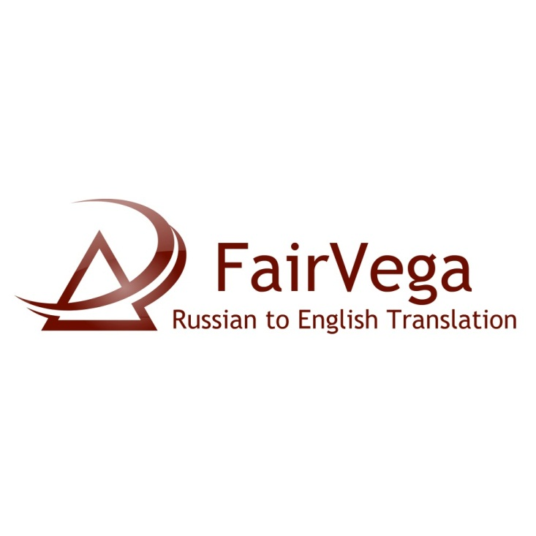
About me
Certified RU>EN translator, 2009
Enthusiastic UZ>EN translator
Full-time freelancer since 2012
Legal, academic, creative texts
Studied international relations, history, culture
Past work as writing tutor, librarian, and bureaucrat

Slide 6

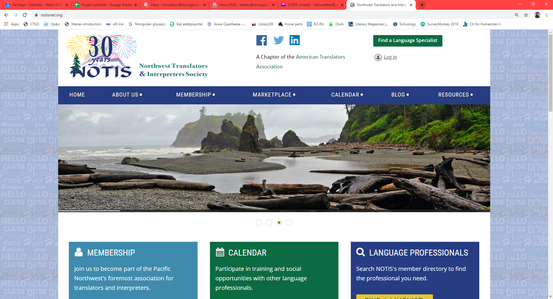

Slide 7

Are you scared of translation?

Slide 8

..or just skeptical?

Slide 9
5 things translators wish editors knew about translation
Northwest Editors Guild, July 13, 2020
Shelley Fairweather-Vega www.fairvega.com

Slide 10
Translators translate meanings, not words.
1

Slide 11
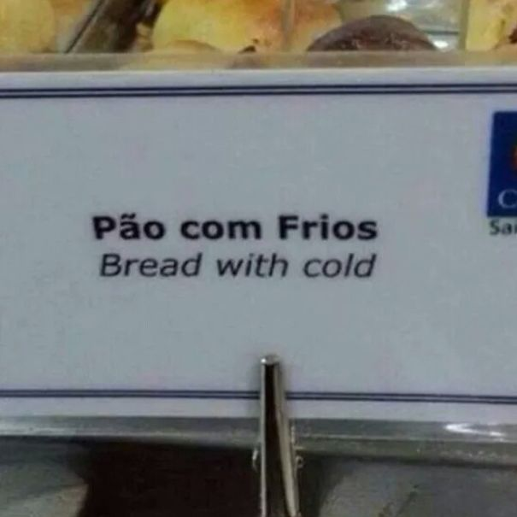
Multiple meanings: Portuguese frios

Slide 12
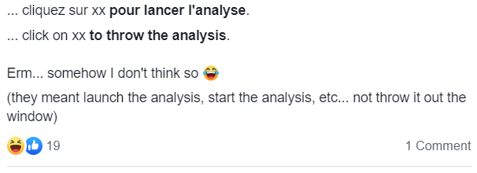
Multiple meanings: French lancer

Slide 13


False friends: Spanish embarazada
Estoy demasiado embarazada!
You’re too pregnant?

Slide 14

Translators translate meanings, not words....
So trust the translator over your dictionary.
1

Slide 15
Translations come in all shapes and sizes
2

Slide 16
How important is this text?
A vital world classic
Just for fun
Notes and explanations
Research
Reference to existing versions
Accurate rendition of style, culture
Readability
Accuracy of priority information
Appropriateness for target culture, audience

Slide 17
What is the purpose of the translation?
Informational
Artistic
Notes and explanations
Precision
Completeness
Readability
Creativity
Author’s voice
Characterization
...requires reporting
...requires re-creating

Slide 18
Poetry for information
Georgy Ivanov, 1949
Russian
Россия тридцать лет живёт в тюрьме.
На Соловках или на Колыме.
И лишь на Колыме и Соловках
Россия та, что будет жить в веках.
Всё остальное — планетарный ад:
Прокля́тый Кремль, злощастный Сталинград.
Они достойны только одного —
Огня, испепелящего его.
English – literal translation
Russia has lived in prison for thirty years.
On the Solovki [islands] or in Kolyma.
And only in Kolyma and the Solovki
Is Russia the one that will live for centuries.
All the rest is planetary hell:
The damned Kremlin, unfortunate Stalingrad.
They are worth only one thing:
Fire, turning it to ashes.

Slide 19
Poetry for art
Georgy Ivanov, 1949
Russian
Россия тридцать лет живёт в тюрьме.
На Соловках или на Колыме.
И лишь на Колыме и Соловках
Россия та, что будет жить в веках.
Всё остальное — планетарный ад:
Прокля́тый Кремль, злощастный Сталинград.
Они достойны только одного —
Огня, испепелящего его.
English – artistic translation
Russia sits imprisoned, lock and key.
Thirty years, Kolyma, Solovki…
Those, the prison camps and prison cages,
Hold the Russia that will span the ages.
All the rest is hell on earthly land:
The cursed Kremlin, ill-used Stalingrad.
They’re worth only one fate that would fit —
Flames, to turn to ashes every bit.

Slide 20

Translations come in all shapes and sizes...
...so ask your translator which type this is.
2

Slide 21

The original text is sacred and inviolable…
...actually, not always.
3

Slide 22
Don't try to edit translated texts into sounding like your favorite author from that country. They should sound like the author being translated.
-Dorothy S.

Slide 23

The original text is not sacred and inviolable…
...so don’t hold your translator too closely to the original.
3

Slide 24
Blame the original.
4

Slide 26
If something in translation looks weird, ask whether it's the same kind of weird in the original.
-Dmitry M.

Slide 27
Ask ‘what is happening here?’ rather than ‘what does the original say?’
-Paula G.

Slide 28
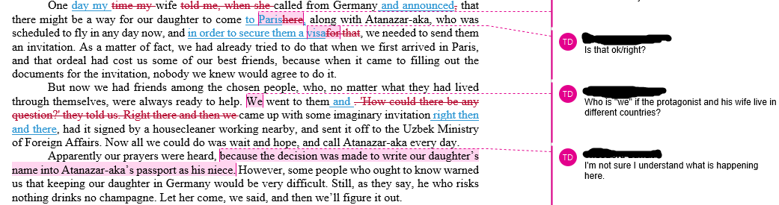
Good “what’s happening?” comments

Slide 29

Blame the original...
...but don’t let us off the hook.
4

Slide 30
Translators are writers.
5

Slide 31
Translators as creative professionals
Work under deadline pressure
Are subject matter experts
Consider style, substance, pace, voice, audience, purpose of each text
Weigh readability and artistry

Slide 32
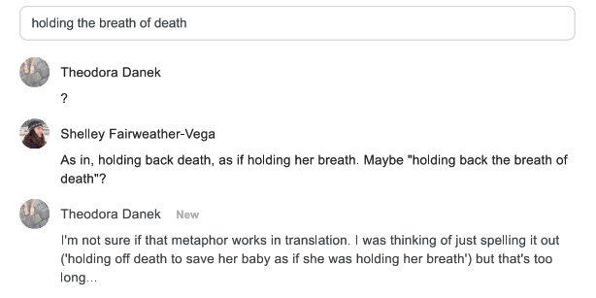
An unhelpful question mark

Slide 33
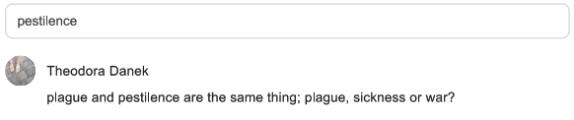
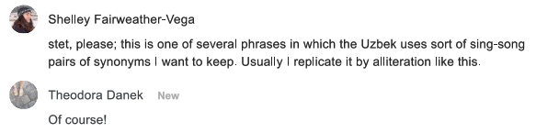
An understanding comment

Slide 34

Translators are writers
...so treat us that way!
5

Slide 35
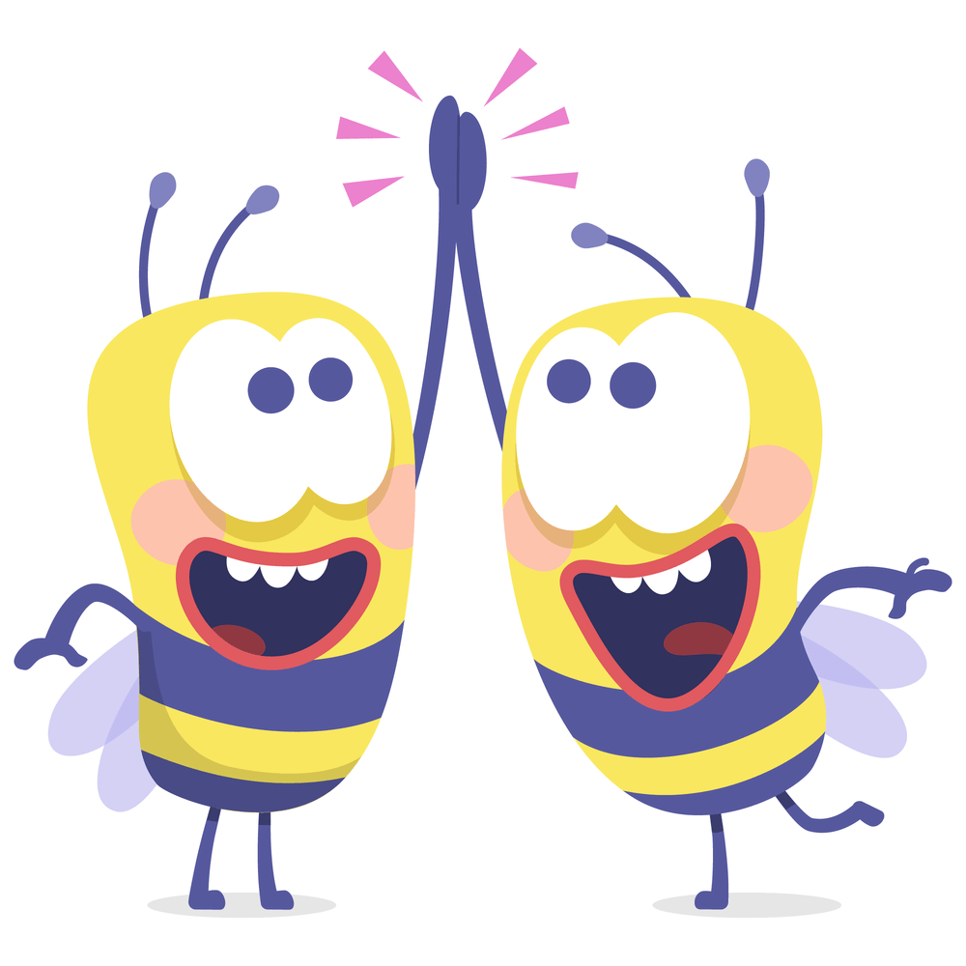
Super bonus point...
We need each other.
6

Slide 36
summary
Translators translate meanings, not words
Translations come in all shapes and sizes
The original text is not always sacred and inviolable
Blame the original, but don’t let us off the hook
Translators are writers
Editors and translators need each other

Slide 37
Thank you!
Contact info
Shelley Fairweather-Vega translation@fairvega.com www.facebook.com/fairvega www.fairvega.com | Northwest Translators & Interpreters Society info@notisnet.org https://www.facebook.com/NOTISnet/ www.notisnet.org
Notes:
And I hope that you learned something too, and enjoyed this presentation, and got some food for thought.
Questions

Slide 38
Thank you for attending the Editing and Translation presentation!
Presenter: Shelley Fairweather-Vega, FairVega Translations
Contact: www.fairvega.com
For more NW Editors Guild event information, go to www.edsguild.org
July 13, 2020
Notes:
Announcer: This concludes the July 2020 member meeting presentation on Editing and Translation. If you have further questions for or would like to connect with Shelley Fairweather-Vega, please contact her at the information provided here and on the Guild website, where you can also find information about more events happening in 2020. Thank you again to Shelley for presenting and thank you all for attending . Good night!

