Slide 1
Accessibility for Editors:
A Starting Point for Making Your Business Accessible
Mary-Colleen Jenkins
mcedits@gmail.com
Notes:
Image of Coffeepot for Masochists created by www.impossibleobjects.com from French artist Jacques Carelman’s 1969 design in Catalogue d’Objets Introuvables. In English, the title is Catalog of Impossible Objects.

Slide 2
Topics
Our session will be divided into 5 parts, each followed by a Quick Fire Activity.
Main Topics will include Best Practices in the following areas:
Accessibility Checkers
Structured Headings
Alternative Text (aka alt text)
Presentation Slides
Social Media

Slide 3
Embarking on this Learning Journey
Today we’re focusing on basic practices in making some elements of a small business more accessible for people with disabilities. We’re focusing on a few skills that can be easily applied across different types of content and that will benefit all of our clients.
As we learn and apply these skills, they become not only habits in our work, but also habit of thought. Accessibility becomes a mindset as well as a skillset.

Slide 4
Philosophy: Progress over Perfection
Start with small tasks that are both manageable and replicable.
Small, scheduled chunks of time can be productive
Partner with peers or colleagues to support one another
Don’t let perfection be the enemy of good.
Notes:
Graphic credit to Mounika.studio
Full description of Progress graphic by mounika.studio. The graphic shows three rows of text alternating with three rows of hand-drawn circles. There are six circles in each row, divided at different parts of the circle with a wavy black line. Above the line, the circle is white. Below the line, the circle is blue. Each circle has a different level of blue – indicating fullness. Some have low levels of blue, some have high levels of blue, and in between. The first line of text says: This is progress. The second line of text says: This is also progress. The third line of text says: And so is this. In short, all levels mean progress.

Slide 5
Quickfire 1:
Reflection

Slide 6
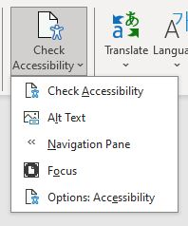
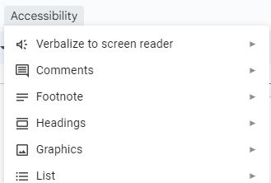
Essential Tool: Accessibility Checkers
Microsoft products have the most robust and interactive Accessibility Checkers. They provide guidance for users at all skill levels.
Google products do not have built-in Accessibility Checkers. Users can download the Grackle docs and Grackle slides plug-in Accessibility Checkers.
Notes:
Grackle Docs Plug-in for Google Products: https://www.grackledocs.com/grackle-for-google-docs-how-it-wor

Slide 7
Best Practices: Structured Headings
Built-in headings are announced by screen readers so users can understand the document’s structure and can make choices in how to navigate content.
We use built-in heading structures because assistive technology cannot recognize headings created manually through font styling alone:
Increasing font size
Bolding text
Underlining text
Italicizing text
Notes:
Authoring tools like Word, Google, Substack, etc. have style tools in the tool bar
Assistive technology cannot recognize unstructured headings
Created by manually increasing font size
Created by manually bolding, underlining, or italicizing text

Slide 8
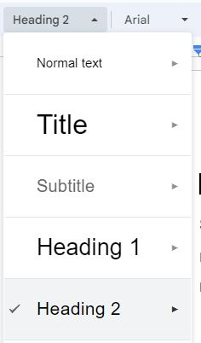
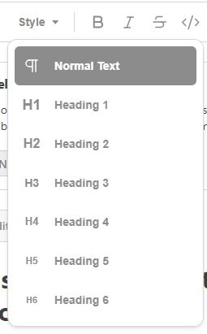
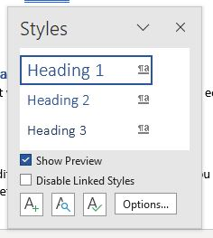
Essential Tool: Headings Styles
Microsoft Word
Substack
Google Docs
Notes:
Grackle Docs Plug-in for Google Products: https://www.grackledocs.com/grackle-for-google-docs-how-it-wor

Slide 9
Quickfire 2: Explore
Open a favorite authoring tool and explore:
--Accessibility Checkers
--Heading Styles
OR
If you use Google products, open your browser and bookmark Grackle Docs so you can check it out later.

Slide 10
Best Practices: Add Alt Text to Images
Alt Text is an abbreviation for “Alternative Text”
Describes exactly what can be seen in an image
Is clear and concise – It takes some practice to build this skill
Reveals the meaning/context to a person who does not see that image
Purely decorative images can/should be hidden from screen readers
Microsoft products have a “Mark as decorative” option in the Alt Text field
Grackle will check for “artifacts,” but may not offer an easy check mark solution like Microsoft products do

Slide 11
Alt-Text Example
“Two apples hanging low on a leafy branch.”
Context:
Presentation about fixing easy accessibility problems, aka “low-hanging fruit.”
Notes:
Do not include the following:
“Image of”
“Photo of”
“Screenshot of”
“Picture of”
No need to include details like color or background if not directly meaningful to the context.
Also, do not include image attributions or titles. If there is a title box in the alt text tool, leave it blank.

Slide 12
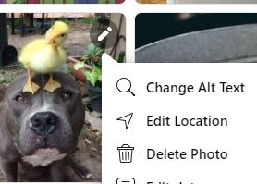
Adding Alt Text in Facebook (1 of 2)
Select photo and look for pencil icon in upper right corner
“Change Alt Text” is the first option in the drop-down menu

Slide 13
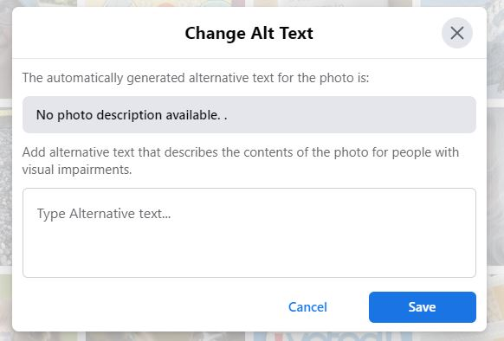
Adding Alt Text in Facebook (2 of 2)
Without Alt text, screen reader users will hear “No photo description available” for every image.
When we add brief alt text that expresses the key details of the image, a person who does not see the image will understand context:
“Large, intimidating dog balancing a small, fluffy duckling on its head.”

Slide 14
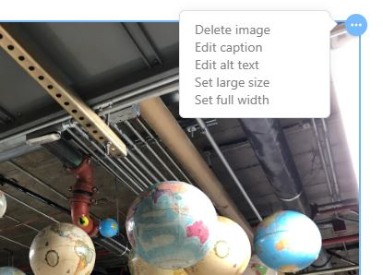
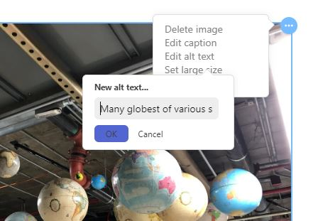
Adding Alt Text in Substack
Select photo and look for three dots (…) in upper right corner. “Edit Alt Text” is the first option in the drop-down menu. The text field is small, but you can use the arrow keys to read and edit the content.

Slide 15
Quickfire 3: Exploring Alt Text
Open a favorite authoring tool or social media platform and see if you can locate the Alt Text field.
OR
Practice writing alt text for an image in one of your documents or social media posts.

Slide 16
Best Practices: Presentation Slides
Give each slide a unique title
Slide titles function as structured headers
If slides in a series share a title, offer an indicator: (1 of 2), (2 of 2), etc.
Add alternative text (alt text) to images
Use templates because they’re built to be accessible
Use strong color contrast and easy-to-read font sizes
Use built-in bullet list formatting
Use animations sparingly, if at all

Slide 17
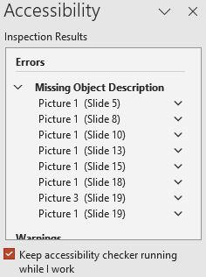
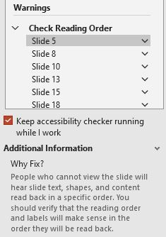
Essential Tool: Accessibility Checker for Slides
Check for Alt Text
Check for Reading Order
Notes:
In the midst of planning and designing a presentation, it can be easy to forget to add alt text to images as you go.
Screen readers read items in the order they are added to the slide. Accessibility Checkers remind us to check for logical order.

Slide 18
Tips for Inclusive Presentations
Keep slide text concise and specific; avoid jargon
Define terms and acronyms
Verbally describe images
Pause to allow audience time to absorb information
Try to avoid figures of speech that may not translate across cultures
In-person? Use a microphone whenever possible
On Zoom? Present with your camera on

Slide 19
Quickfire 4: Pause and Consider
Based on what we’ve covered so far…
What is one accessibility tip or practice that you currently do or could do?
Share in the chat, if you’re comfortable doing so.

Slide 20
Best Practices: Social Media
Alt text for images
Descriptive Links
Hashtags
Emojis
Avoid automatic videos or flashing animations
Use Inclusive stock images

Slide 21
Best Practices: Descriptive Live Links
Embed live links into the text:
YES: “Connect with me on LinkedIn.”
NO: “Connect with me on LinkedIn at www.linkedin.com/in/mcjseattle.”
Use descriptive live links to avoid phrases like “click here.”
YES: “Connect with me on LinkedIn.”
No: “To connect with me, click here.”
Notes:
N

Slide 22
Best Practices: Hashtags (1 of 2)
Avoid creating hashtags that are all lower case. Use Pascal Case (aka Camel Case) instead.
YES: #WebAccessibility
A screen reader will pronounce this as “Web Accessibility”
NO: #webaccessibility
A screen reader will pronounce this as “weebaccessibility”
Notes:
N

Slide 23
Best Practices: Hashtags (2 of 2)
Avoid replacing words with hashtags in the middle of a sentence or paragraph.
NO:
“Always keep #WebAccessibility top of mind when designing #InclusiveContent.
YES:
“Always keep web accessibility top of mind when designing inclusive content.”
#WebAccessibility #InclusiveContent
Notes:
N

Slide 24
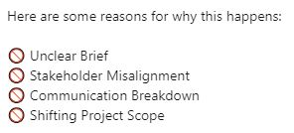
Best Practices: Emojis
Practices to Avoid
Okay Practices
Replacing words with emojis
Integrating multiple or repeated emojis within a paragraph
Separating words in a sentence with emojis
Using emojis that have unclear meaning
Using emojis that lack contrast against a background
Intentional use of emojis – for the right time and place
Using emojis at the end of a sentence
Using a clear and understandable emojis for bullet points in social media
Notes:
N

Slide 25
Best Practices: Inclusive Stock Images
When selecting stock images for business materials, include images of disabled people.
More and more we see marketing and advertising that showcases our diverse communities. We see better representation of historically marginalized people and groups in across media. It’s not perfect, by any means, but it’s better.
However, inclusive imagery that includes disabled people, both with and without assistive technologies is still pretty rare.
See the Resource List for links to stock image resources that include people with disabilities.

Slide 26
Quickfire 5: Pause and Consider
Thinking about Social Media…
What is one social media tip or practice that you currently do or could do?
Share in the chat, if you’re comfortable doing so.

Slide 27
Remember! Progress over Perfection
Learning new accessibility skills and putting them into practice is a journey.
Making small changes, making incremental progress may feel slow and frustrating.
But small change is valuable change. And it builds and builds over time.
Notes:
Graphic credit to Mounika.studio
Full description of Progress graphic by mounika.studio. The graphic shows three rows of text alternating with three rows of hand-drawn circles. There are six circles in each row, divided at different parts of the circle with a wavy black line. Above the line, the circle is white. Below the line, the circle is blue. Each circle has a different level of blue – indicating fullness. Some have low levels of blue, some have high levels of blue, and in between. The first line of text says: This is progress. The second line of text says: This is also progress. The third line of text says: And so is this. In short, all levels mean progress.

Slide 28
Questions?

